Slide 1
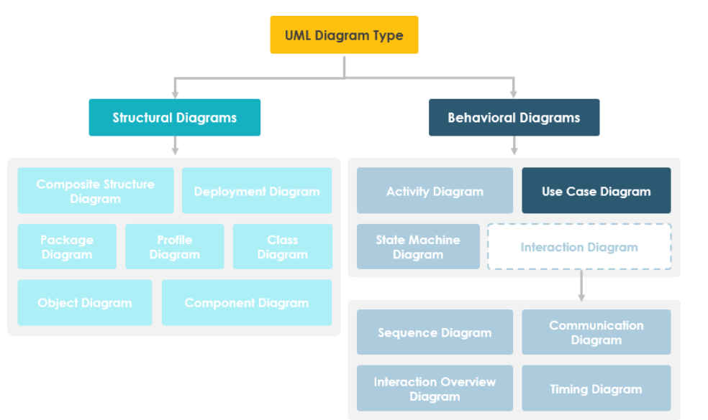
Use Case Diagram
Amir Dirin
2023

Slide 2
Use case
Use case diagram
Functional requirments
Non-functional requirements
Actor
include
Extend
Use case specification/definition/ description
Flow of events
Non-functional requirements / shadow use case

Slide 3
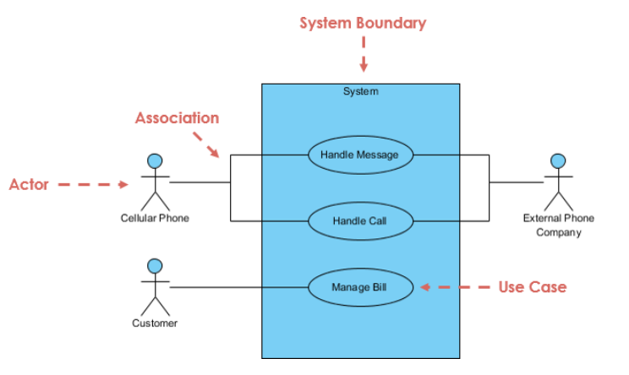
User Case Diagram
Use cases represent system functionality the requirements of the system from user’s perspective
Specify the context of a system
Capture the requirement of a system
Validate a system, architecture
Drive implementation and generate test cases
A diagram that shows a set of use cases and actors, and their relationships

Slide 4

Notations
Use Case: sequence actions, including variants, that system performs that yields an observable value to an actor
Actor: The people or systems that provide or receive information from the system. The stakeholders of a system.
Include: Specifies that the source use case explicitly incorporate the behaviour of another user case at a location specified by the source
Extend: Specifies that the target use case extends the behaviour of the source.

Slide 5
Use Case Diagram
Could be human beings other systems, timers and clocks or hardware devices
The primary actors (actor).
Actors that only stimuli from the system are called secondary actors (passive)

Slide 6
Actors
Who / what will be interested in the system?
Who / what will want to change the data in the system?
Who / what will want to interface with the system?
Who / what will want information from the system?

Slide 7
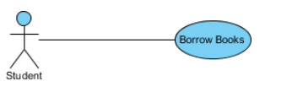
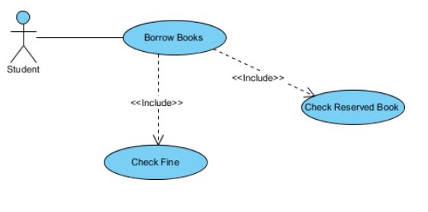
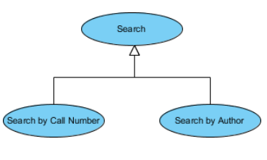
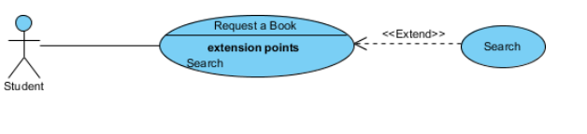
EXAMPLE
Include Relationship
1
2
Extend Relationship
Generalization Relationship
3
4
Adapted From: https://www.visual-paradigm.com/guide/uml-unified-modeling-language/what-is-use-case-diagram/

Slide 8
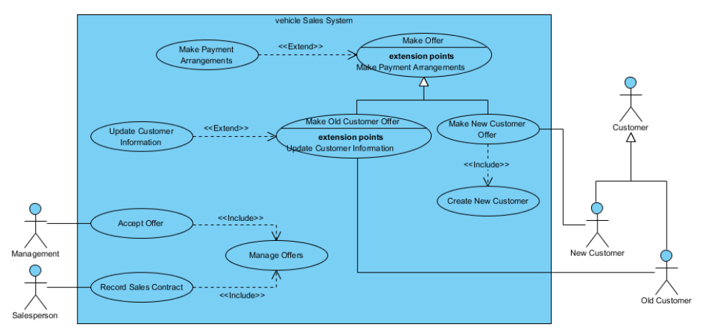
Vehicle Sales Systems

Slide 9
Exercise
Create a use diagram which describe the relations of actors and actions.
A resturant have different actors for example,
Waiter, Client, Cashier, and Chef

Slide 10
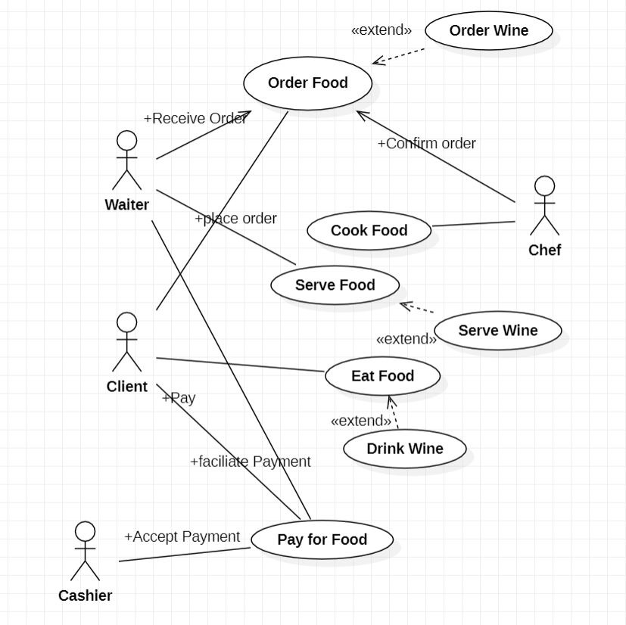
Answer

Slide 11
Exercise 2
Create a use case diagram for web for library managment system at university
Actors:
Users (Student, Staff)
Liberian
Database

Slide 12
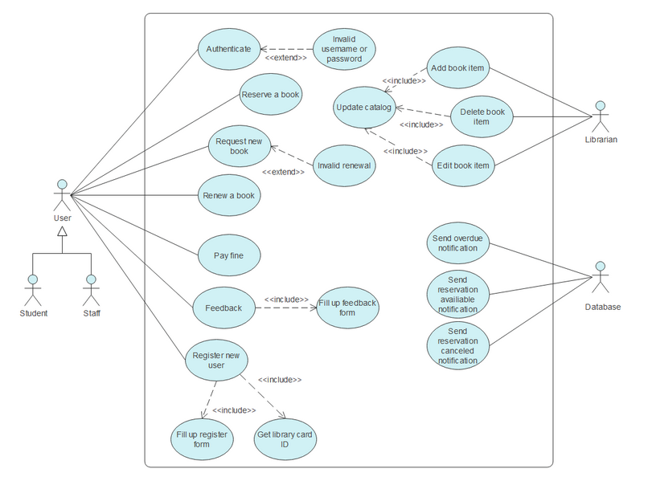
Answer

